Slide 1
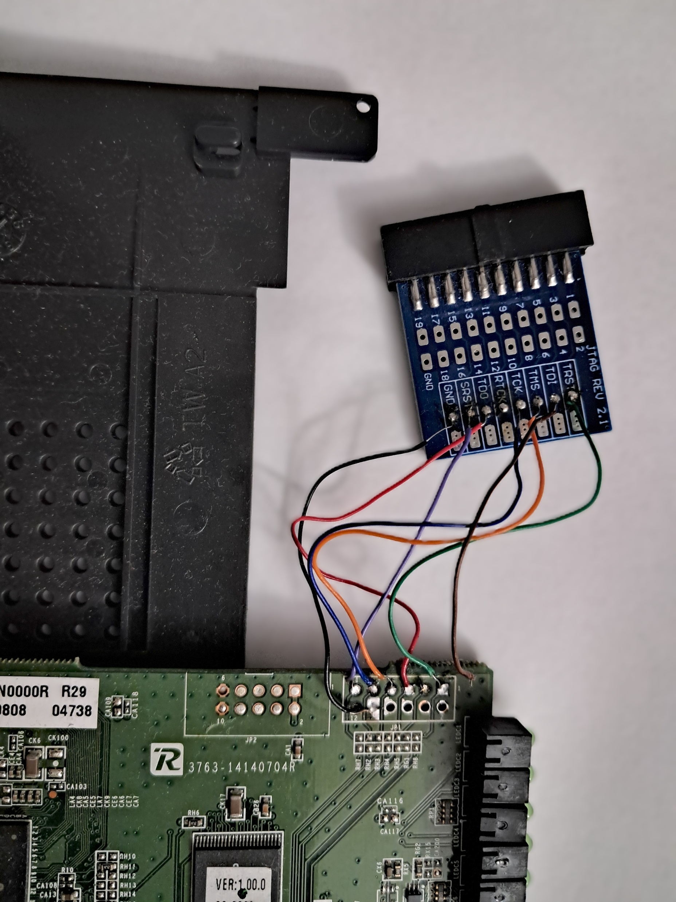
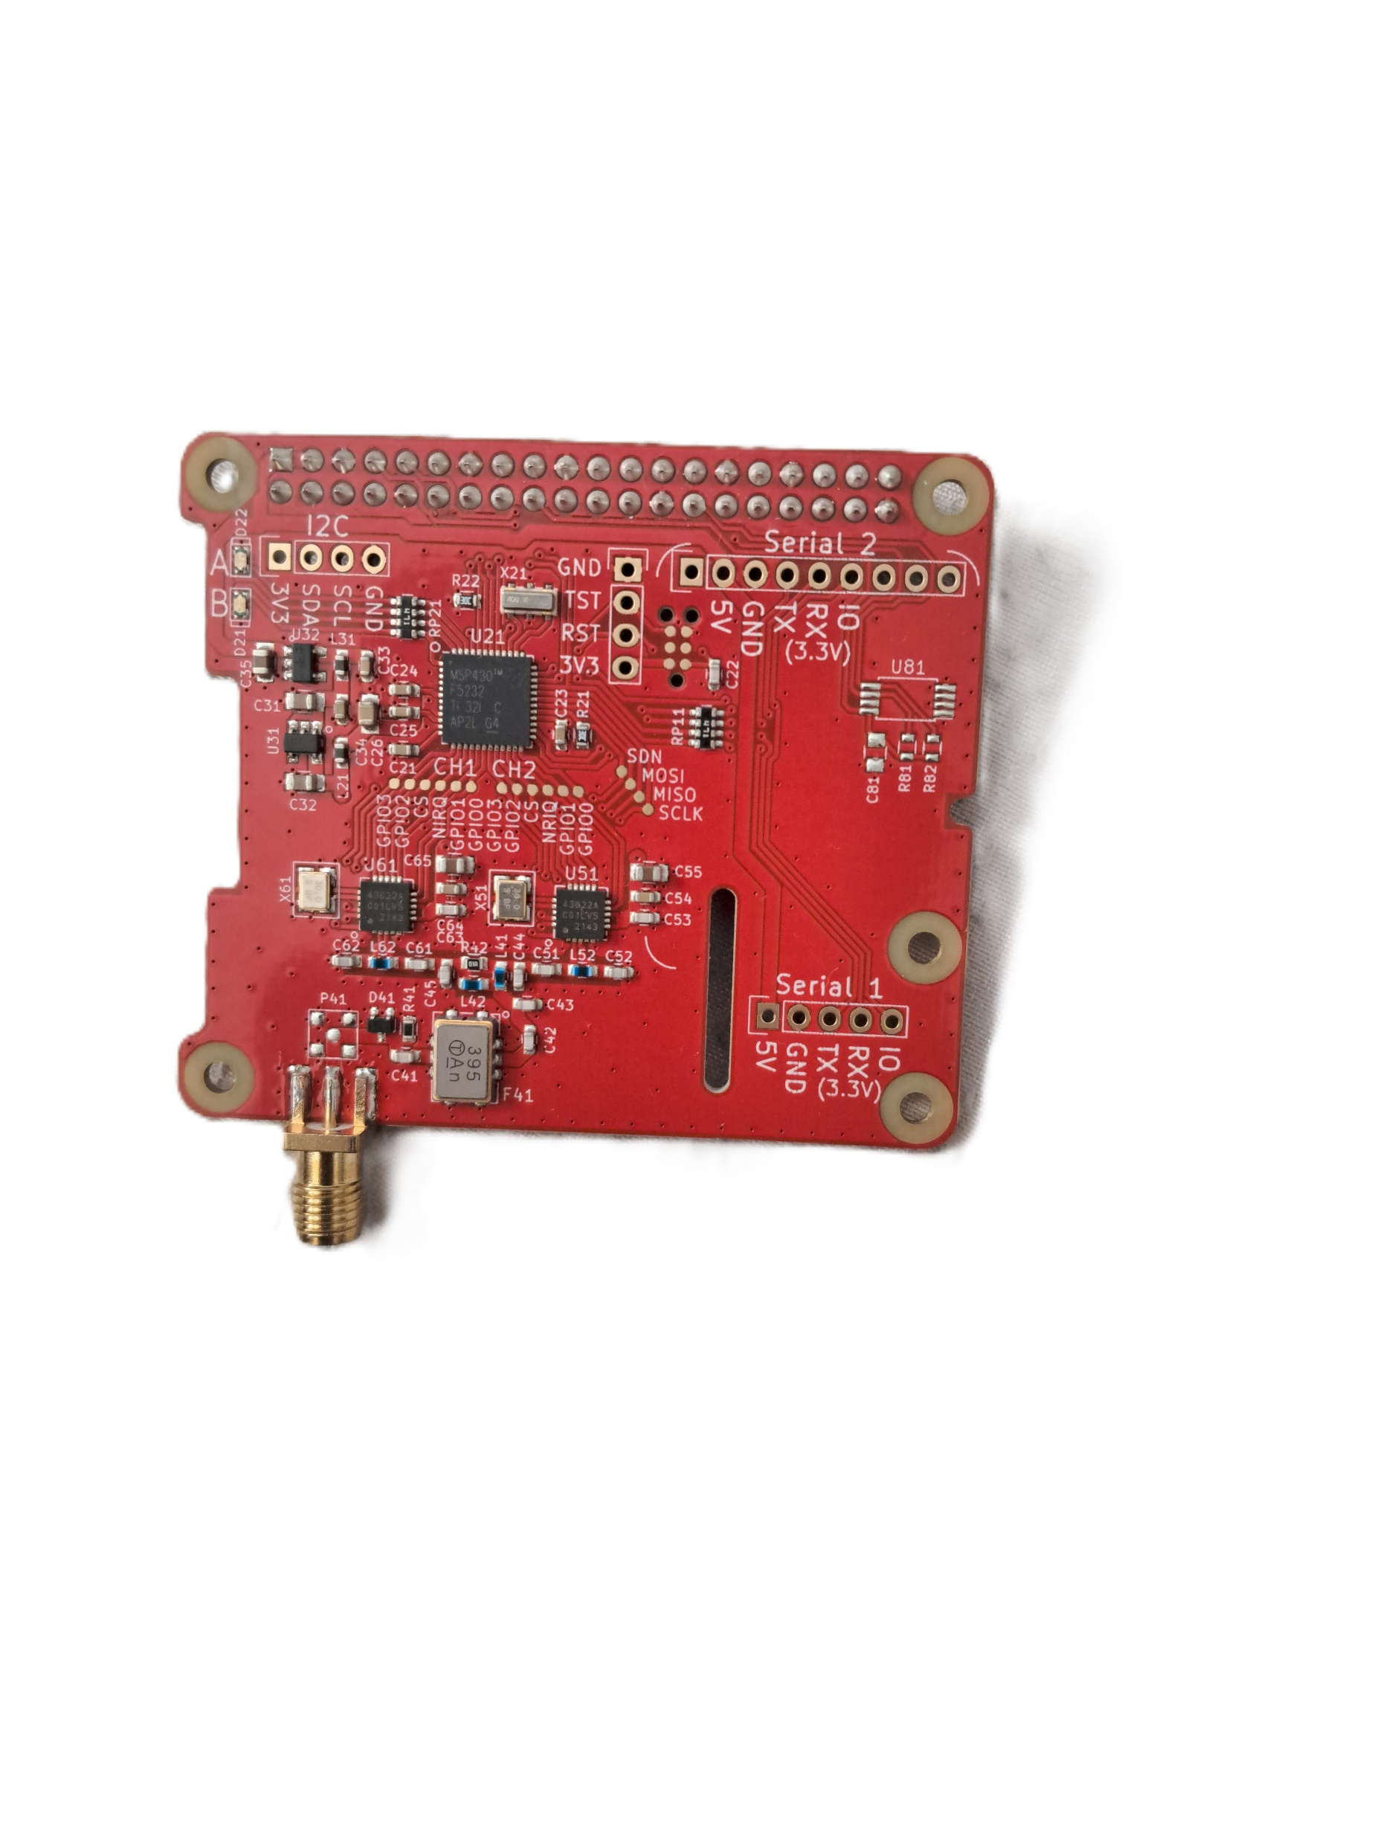
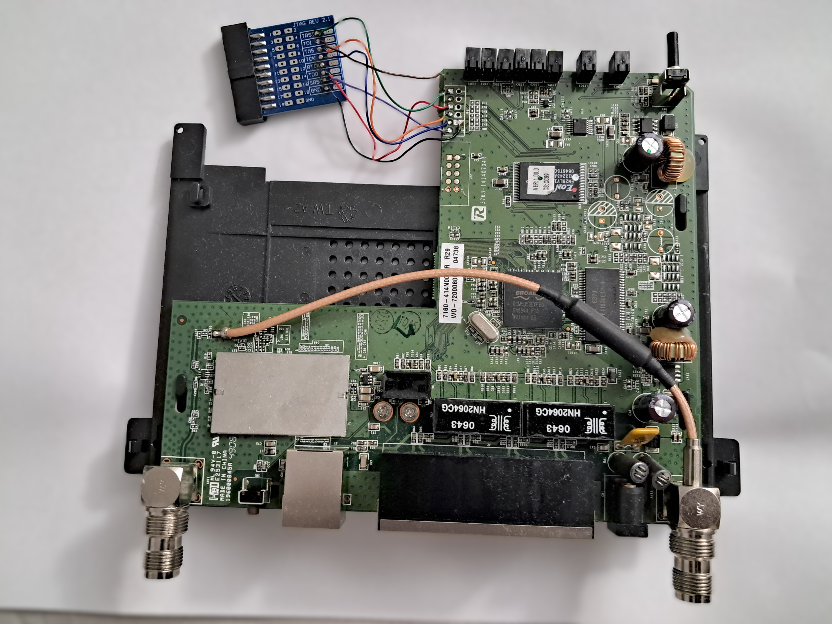
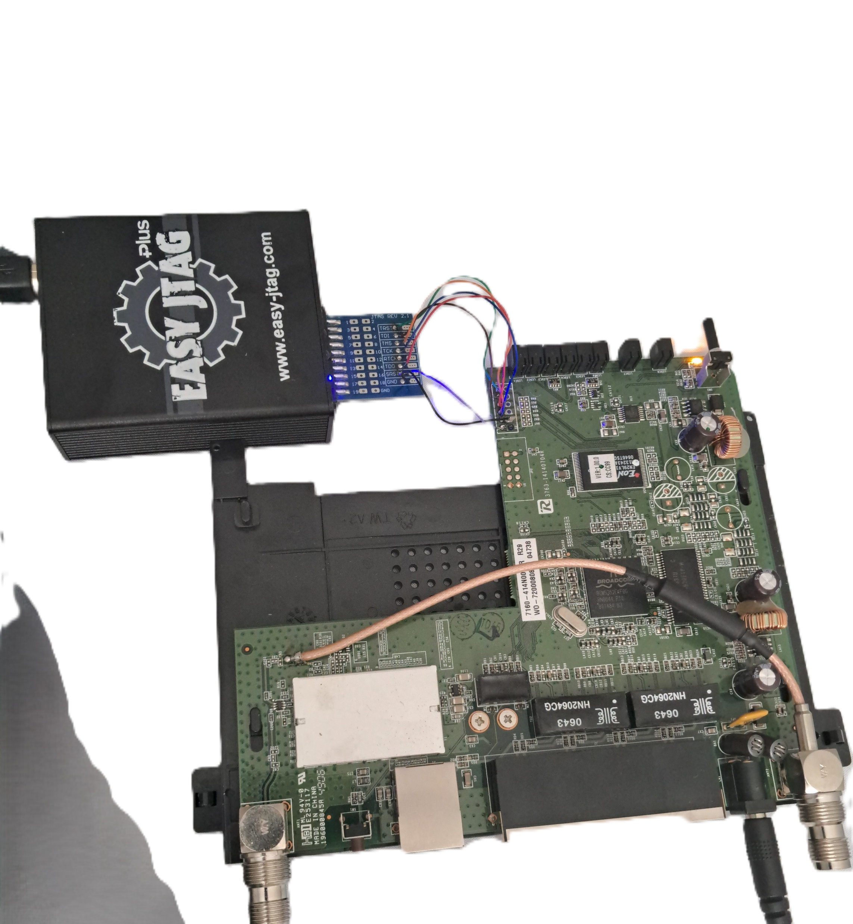
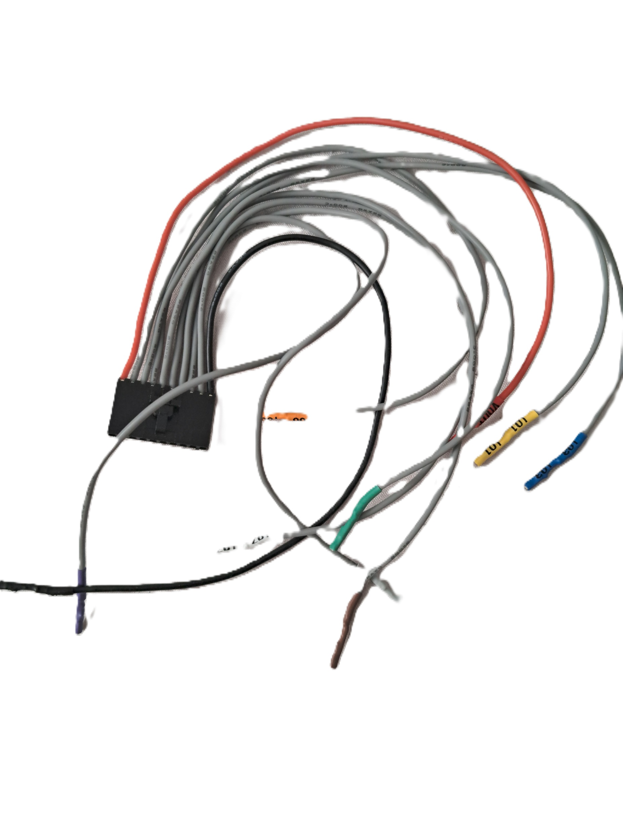
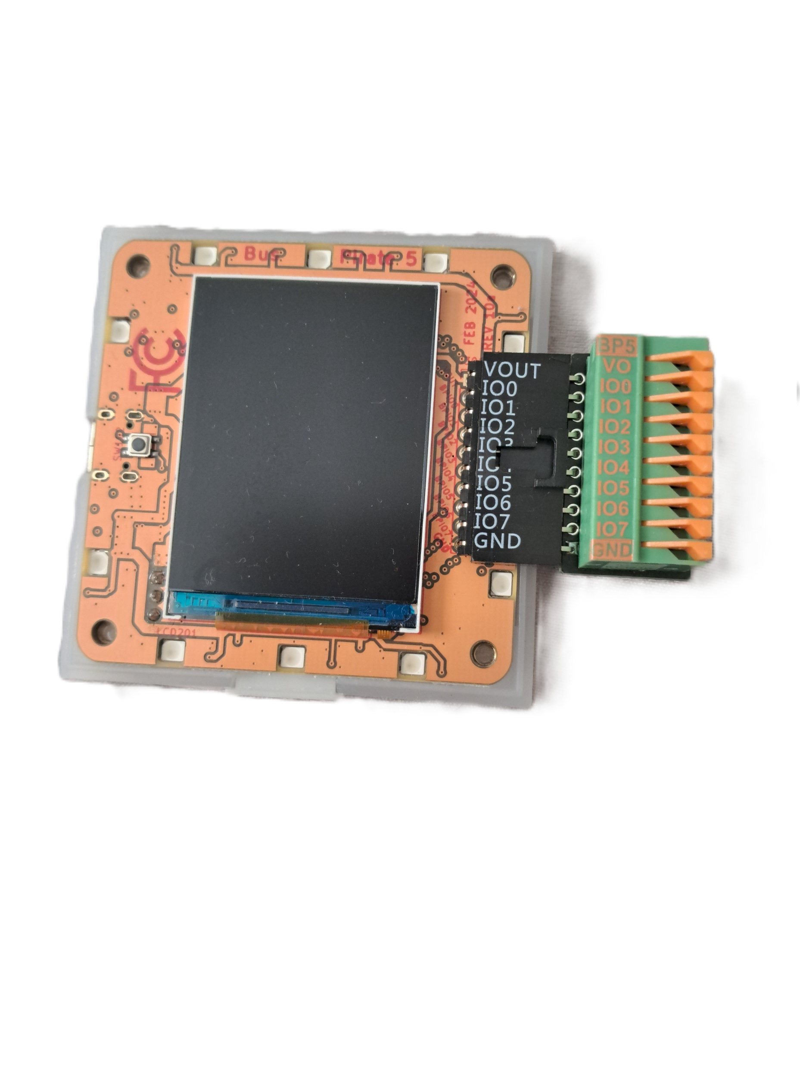

Firmware Extraction Using JTAG and UART
Prudhvi Raj Dasari
Department of Computer Science & Information Systems
University of North Carolina Wilmington
Abstract:
Embedded devices rely on firmware that controls boot, hardware drivers, and network services. Because firmware is stored in non-volatile memory and updated infrequently, vulnerabilities can persist long after deployment.
This project presents a practical, reproducible methodology to extract firmware using hardware debug interfaces (JTAG/UART) and—when JTAG is unavailable—an SPI fallback with Bus Pirate.
We document pin discovery, connection stability (SRST without TRST), safe dumping procedures, and integrity verification.
The workflow yields a raw binary image suitable for analysis and lays groundwork for auditing embedded device security.
Problem.
Many embedded devices ship with outdated libraries, hardcoded credentials, and infrequent security updates. Debug interfaces are often undocumented, leaving vulnerabilities hidden for years.
Objectives.
Identify and verify JTAG/UART pins on the target device
Extract a complete flash image (.bin) and validate integrity (checksum)
Document a stable configuration (low JTAG speed, SRST init)
Provide an SPI fallback using Bus Pirate + flashrom
Outline security checks (default creds, exposed services, outdated components)
Results
Extraction outcome.: Stable connection using SRST, successful CPU detection, and complete dump (2 MB). Two consecutive reads produced matching SHA-256 checksums, confirming integrity.
Quick triage of image.: strings/hexdump revealed configuration and init scripts; evidence of legacy services (e.g., telnet) and older crypto libs (version checks pending). The binary is now ready for deeper, tool-based auditing (Binwalk/Ghidra) or emulation (QEMU) as future work.
System & Tools
Hardware. Multimeter (continuity pin mapping), Easy JTAG Plus (primary), Bus Pirate v5 (SPI fallback), soldering tools & jumpers.
Software. Easy JTAG Tool (read/handshake), Linux terminal (dd, cat, sha256sum), flashrom (Bus Pirate), basic inspection (strings, hexdump).
Output. Raw binary image (firmware.bin) — a byte-for-byte flash dump (not an .exe/.elf).
Methodology
Pinout verification.:vContinuity test → locate GND; trace & test TCK, TMS, TDI, TDO, SRST (TRST absent). Use SRST init in software.
JTAG configuration.:Set JTAG speed < 1000 kHz for stability; select SRST (ignore TRST). Confirm IDCODE/handshake in log.
Firmware dumping (JTAG route).:Read full flash: Start 0x00000000, Length 0x00200000 (2 MB). Verify with sha256sum.
SPI fallback (Bus Pirate).:Wiring (typ.): IO4→MOSI, IO5→MISO, IO3→CLK, IO2→CS, GND, (optional VOUT=3.3V when the board is unpowered).
Conclusions.
A repeatable hardware workflow for firmware extraction was demonstrated.
TRST is not mandatory; SRST with low JTAG speed ensured reliability.
The process yields a verified .bin image suitable for security analysis.

